Slide 1
Articulate Rise KickStarter
CHEP Webinar Learning Series – Session 3
April 22, 2022
Craig Rebich
Senior Learning Strategist
crebich@vivayic.com
Notes:
Planning Notes

Slide 2
CHEP Webinar Learning Series Overview
Enabling a Successful Training Initiative – March 10, 2022
Working session to determine an effective training process
Clarity Maps and Instructional Design Templates – March 25, 2022
Training session to identify a clarity maps, tools, templates, and determine when and how to use them.
Articulate Rise Kickstarter Session – April 22, 2022
Training session to learn the basics of Articulate Rise
1
2
3
Notes:
In this session, we’ll learn what a clarity map is, determine what questions to ask to create a clarity map, learn the overall design process, and discuss the tools and templates required to build out online modules throughout the design process.

Slide 3
Today’s Goals and Agenda
Goal: Discuss the tools and templates in the design process
Agenda
11:00 AM – Welcome/Review/Overview
11:15 AM – Determine the key features of Articulate Rise
11:30 AM – Identify when to use Rise
11:40 PM – Features in action
12:20 PM – Wrap-up & Next Steps
Notes:
In this session, we’ll learn what a clarity map is, determine what questions to ask to create a clarity map, learn the overall design process, and discuss the tools and templates required to build out online modules throughout the design process.

Slide 4
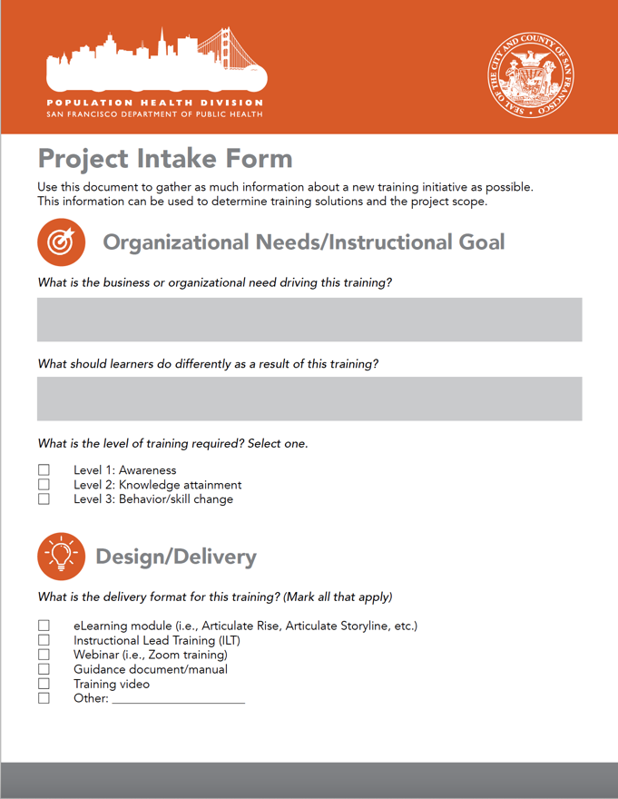
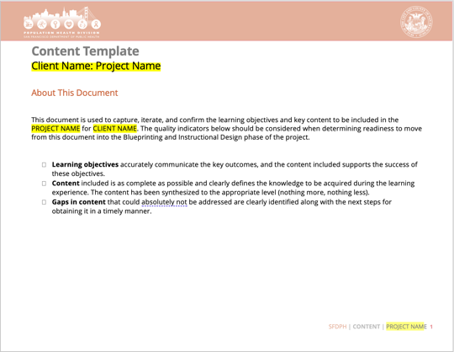
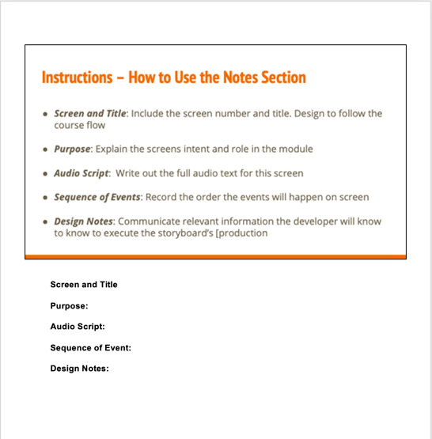
Project Intake Form + Clarity Map + Design
1
3
2

Slide 5
Review
What tools, process, or steps have you used in the last few weeks?
OR
What tools, process, or steps are you excited to use in the next few weeks?
1
2
RECORD YOUR ANSWERS IN THE CHAT

Slide 6
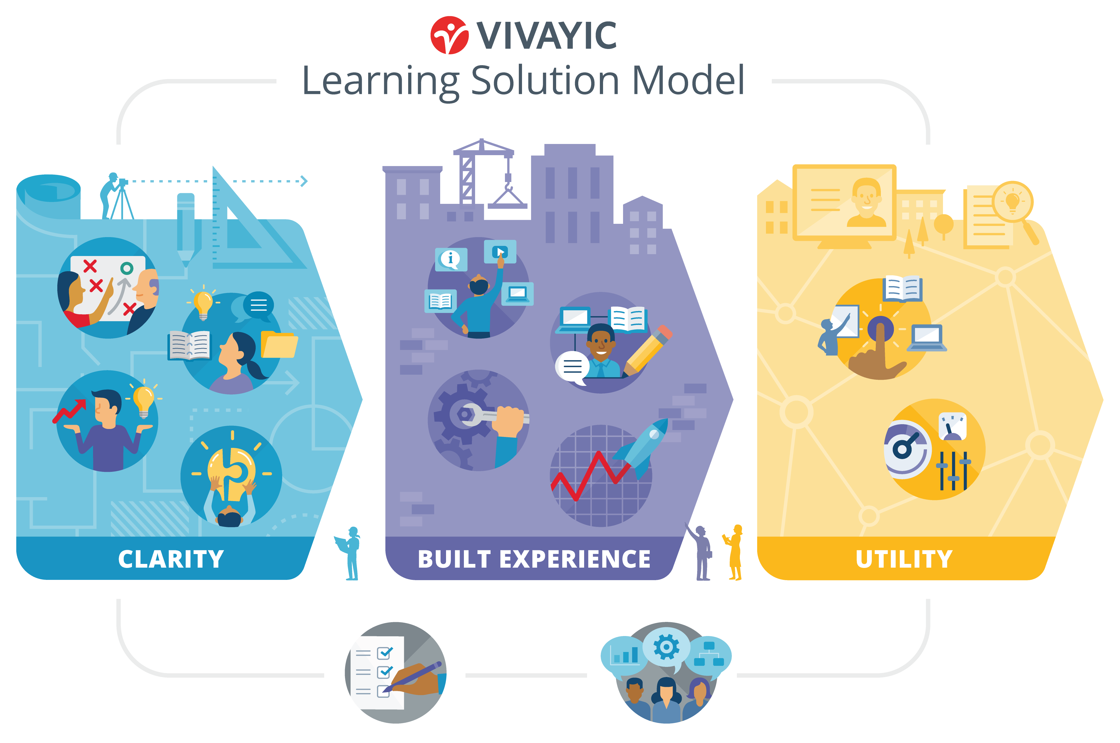
Things to Consider
Notes:
Padlet - https://padlet.com/rcreasy/d4wy0c6dwe33c0ln
What information needs collected?
What are the main steps for this process?
Who needs to be involved?

Slide 7
Things to Consider – Built Experience
What’s This About?
Building the learning experience
Graphic/UX identity
Prototype/pilot/improve
Tools
Knowledge document (content)
Blueprint (content + design)
Storyboard (content + design + visuals)
Development review tools (Alpha, Beta, Final)
Notes:
Padlet - https://padlet.com/rcreasy/d4wy0c6dwe33c0ln
What information needs collected?
What are the main steps for this process?
Who needs to be involved?

Slide 8
What is Articulate Rise
https://articulate.com/360/rise

Slide 9
Why Articulate Rise
Pros
Cons*
Web Browser based
Responsive
User friendly
Quick development time
Engaging, built-in interaction
Limited ability to customize
Limited formatting ability
Limited creative ability
* Integration work arounds:
Storyline blocks
Type forms
H5P Plug ins

Slide 10
Review
In what situations, would you select Rise over another development tools?
1
RECORD YOUR ANSWERS IN THE CHAT
Notes:
Example - https://www.dropbox.com/s/c3pfhnqwimgyzsu/SFDPH_Overdose_Recognition_EKP_Final.docx?dl=0

Slide 11
Why Articulate Rise
Pros
Cons*
Web Browser based
Responsive
User friendly
Quick development time
Engaging, built-in interaction
Limited ability to customize
Limited formatting ability
Limited creative ability
* Integration work arounds:
Storyline blocks
Type forms
H5P Plug ins
When to Use Rise
Compliance training
Text based content
Working together
Mobile learning
Short time frame
508 Compliance

Slide 12
Learning Levels and Development
4
3
2
BEHAVIOR CHANGE
1
APPLICATION & SKILL DEVELOPMENT
KNOWLEDGE ATTAINMENT
AWARENESS
Rise
Storyline
Consideration
Cost, Time and Resources
Notes:
Facilitator Notes:
Let’s dig a big deeper into the levels of learning, which provide us with a common language and framework for identifying and assessing levels of learning.
Unpack each level in more detail, using the graphic on the screen.
Make the connection between designing at a specific level and how the blueprint if flexible enough to work. Also connect this to the Project Intake Form

Slide 13
Consideration Questions When Designing
How can other elements or tools be incorporated into Rise?
What are possible work arounds to a Rise limitation?
How can use Rise differently than as a linear based learning module?
How do I prevent Rise from driving my approach to design?

Slide 14
Rise Demo

Slide 15
What Do You Think?
What is your reaction to Rise and its compatibilities?
In what situation do you see using Rise in your organization?
1
2
RECORD YOUR ANSWERS IN THE CHAT
Notes:
Example - https://www.dropbox.com/s/c3pfhnqwimgyzsu/SFDPH_Overdose_Recognition_EKP_Final.docx?dl=0

Slide 16
Wrap up & Next Steps
Craig to send Rise resources

