Slide 1
GPP Online Training March 2016
Anne Schley
Jessica Handibode

Slide 2
Who We Are
CLI
AVAC
GPP Cohort
GPP Online Training

Slide 3
Good Participatory Practice
Online Training
a hands-on course that brings the GPP Guidelines to life.

Slide 4
GPP guidelines, second edition

Slide 5
What are the course’s objectives?
Strengthen knowledge of the GPP Guidelines, including the GPP principles, 16 topic areas, and key participatory practices throughout the trial lifecycle
Review trial-specific strategies and activities for stakeholder identification, prioritization, and engagement
Identify responsibilities of trial implementers, sponsors, and funders for GPP compliance
Develop a context-specific community engagement or action plan

Slide 6
GPP Course Components
Interactive Modules
10 interactive modules, focusing on unique components of GPP
Animation, case studies, practice activities and narration
Knowledge Checks
Occur at the end of each module
Assess knowledge of the content covered
Not graded and do not count towards certificate of completion
Discussion Forums
Respond to weekly questions
Respond to other learners’ posts
Learners can moderate their own thread
Follow forum guidance

Slide 7
GPP Course Components
Work Assignments
Assignments that relate directly to the implementation of GPP in learners’ contexts
Completed and uploaded work assignments count towards certificate
Baseline assessment and final evaluation
Basic knowledge assessment of core GPP concepts
Evaluation of course components
Focus group discussions are conducted at the end of the course (optional but encouraged)
Certificates
Certificates are only awarded to learners who complete ALL track requirements, as listed in the Course Syllabus

Slide 8
Track A Requirements
Baseline assessment due this week!
10 online modules (self-guided, to be completed weekly)
10 written work assignments, aimed at helping learners articulate a broad stakeholder engagement approach for multiple trials
Final assignment is a strategic engagement program plan
Individual check-in’s with faculty to review each learner’s existing trial-specific work plan
Course evaluation
Webinars are not required but strongly encouraged

Slide 9
Track B Requirements
Baseline assessment due this week!
10 online modules (same content as Track A)
5 written work assignments, including broad GPP action plan
Participation in the discussion forum (must respond to the weekly discussion question for 7/10 lessons)
Course evaluation
Webinars are not required but strongly encouraged

Slide 10
Commitment and Expectations
Approximately 5-7 hours each week,:
Modules ~ up to 120 minutes
Work Assignments ~can vary in length, but up to 120 minutes
Forum Discussions ~ 20 minutes
Webinar and Skype Check-in’s (optional) ~ 60 minutes
Discussion Forums
Please read and follow forum guidance!
A post that counts towards course requirements is a response to the weekly discussion question. Other posting is encouraged but is not counted for course credit.
Learners are encouraged to start their own discussion threads and moderate the conversation! Refer to the forum guidance for more information.
Work Assignments
Upload completed work assignments to the corresponding lesson page by due date
Receive feedback from instructor within one week after the end of each lesson
Notes:
The activities can be completed at any time during each week—learners do not have to be online at any specific time.

Slide 11
Learning Management System
URL: LearnSFDPH.org
The LMS can accessed on a laptop computer or iPad
Best browsers are Firefox and Chrome
For more information about optimizing your LMS viewing, please refer to the Technical Considerations section in the Course Syllabus

Slide 12
Offline Viewing
Only the interactive modules can be viewed offline
Work assignments must be downloaded and submitted while online
Discussion forum only active while connected to the internet
In order to initially download modules for offline use later, you must be connected to the internet and logged-on to the LMS
Two offline viewing options for a computer and iPad:
Access both links on each lesson page
Click on the hyperlink, depending on your desired viewing option, and then download the module
See further instructions in the course syllabus
Notes:
Explain that pdfs must be downloaded with internet connection, so pdfs of the GPP Guidelines, for examples, cannot be viewed while working offline

Slide 13
GPP Guidelines Document
Keep a copy of the guidelines on hand while completing the course
You may either use a hard copy of the GPP Guidelines Document or download a PDF of the guidelines here

Slide 14
Communication Throughout the Course
Emails and announcements via our GPP account: gpponlinecourse@gmail.com
Webinars: Bluejeans
Different webinar time slots to fit different schedules
Refer to the schedule in the Course Syllabus
Office hours on Tuesday, March 29th at 8am ET/ 2pm SA, for assistance and troubleshooting!
Give the Bluejeans handouts to your IT person on site, to ensure your computer settings are correct
Check-ins: Skype
Jessica: Jess_handi
Anne: anne.schley.1

Slide 15
LMS Basics: Log-In
Enter your username (your email address)
Enter your password
If you forget your password, retrieve it by clicking “Lost your password?” or email Anne @gpponlinecourse
Notes:
Reminder to log-in and change password, forgot your password

Slide 16
My Learning Page
You are enrolled!
After logging in, you are directed to the My Learning page.

Slide 17
My Learning
Then click GPP Online Training_Track A or B_Mar 2016
If your page looks different, please send an email with a screenshot to gpponlinecourse@gmail.com
Notes:
YOU WILL SEE TRACK A or B

Slide 18
GPP Online Training Course
On this page you’ll see:
Course Lessons
Announcements
Pending Assignments
Discussion Forum Topics
Your Classmates

Slide 19
GPP Online Training Course
The start and end dates of each lesson fall on a Tuesday
Viewable lessons turn green when your mouse hovers over them
Content for each lesson will be available on Tuesday morning of a lesson’s start date
Return to previous lessons as needed

Slide 20
Lesson Page
On this page, similar to all lesson pages, you will see:
A few steps that learners must complete each week
Upload work assignments
Announcements
Pending AND completed assignments
Discussion forum topics
Click here to view each module

Slide 21
Online GPP Modules
0
Notes:
Maybe make a note about X and Exit button?

Slide 22
Work Assignments
Click the hyperlink to download the work assignment
Notes:
Lessons officially begin on a Monday. Always be able to go back to previous lesson. Do not move ahead. Lessons available the Friday before the Monday of each week

Slide 23
Completing Work Assignments
Download in Microsoft Word
Complete the assignment with input from your colleagues when possible
Save the completed document and include CRC name in the file name (i.e. Lesson 1 Work Assignment_your name.docx)
Complete the assignment here

Slide 24
Uploading Work Assignments
Choose the file (i.e. Lesson 1 Work Assignment.docx) and Click Upload

Slide 25
Uploading Work Assignments
Optional: Add comments that only the instructor will see.

Slide 26
My Files
Under the “My Files” page, you can view all of the files you have uploaded throughout
the course. “Association” indicates where you uploaded the file – either as a reply to a topic (GPP
Discussion Forum ) or as a work assignment on a lesson’s page (GPP Online Training)

Slide 27
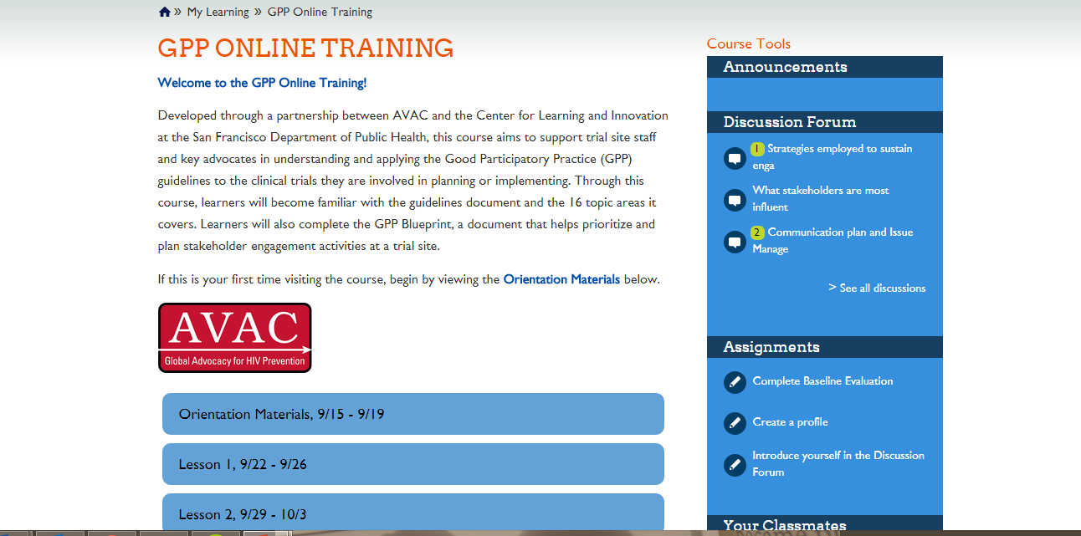
Discussion Forum
From the My Learning page or GPP Online Training page, click on
the discussion forum topic links to the right

Slide 28
Discussion Forum
Discussion Forum Topics
Click on a discussion forum topic that you want to participate in (i.e. Lesson 1)

Slide 29
Discussion Forum – Topics
Discussion Forum Question
Replies

Slide 30
Discussion Forum –
Topic Replies
Participate in the discussion by entering your reply and clicking submit.
If you are replying to someone’s comment, type “RE: [name]”and then type your reply (i.e.RE: Jonathan. I agree with your suggestion…)
Optional: Add a URL link, image, or document to your reply
Notes:
This space will be used to share plans and assignments with other members of the group in order to receive comments.

Slide 31
Log Out

Slide 32
Questions?

Slide 33
Contact Us
Email Anne and Jessica anytime at:
gpponlinecourse@gmail.com

